Slide 1
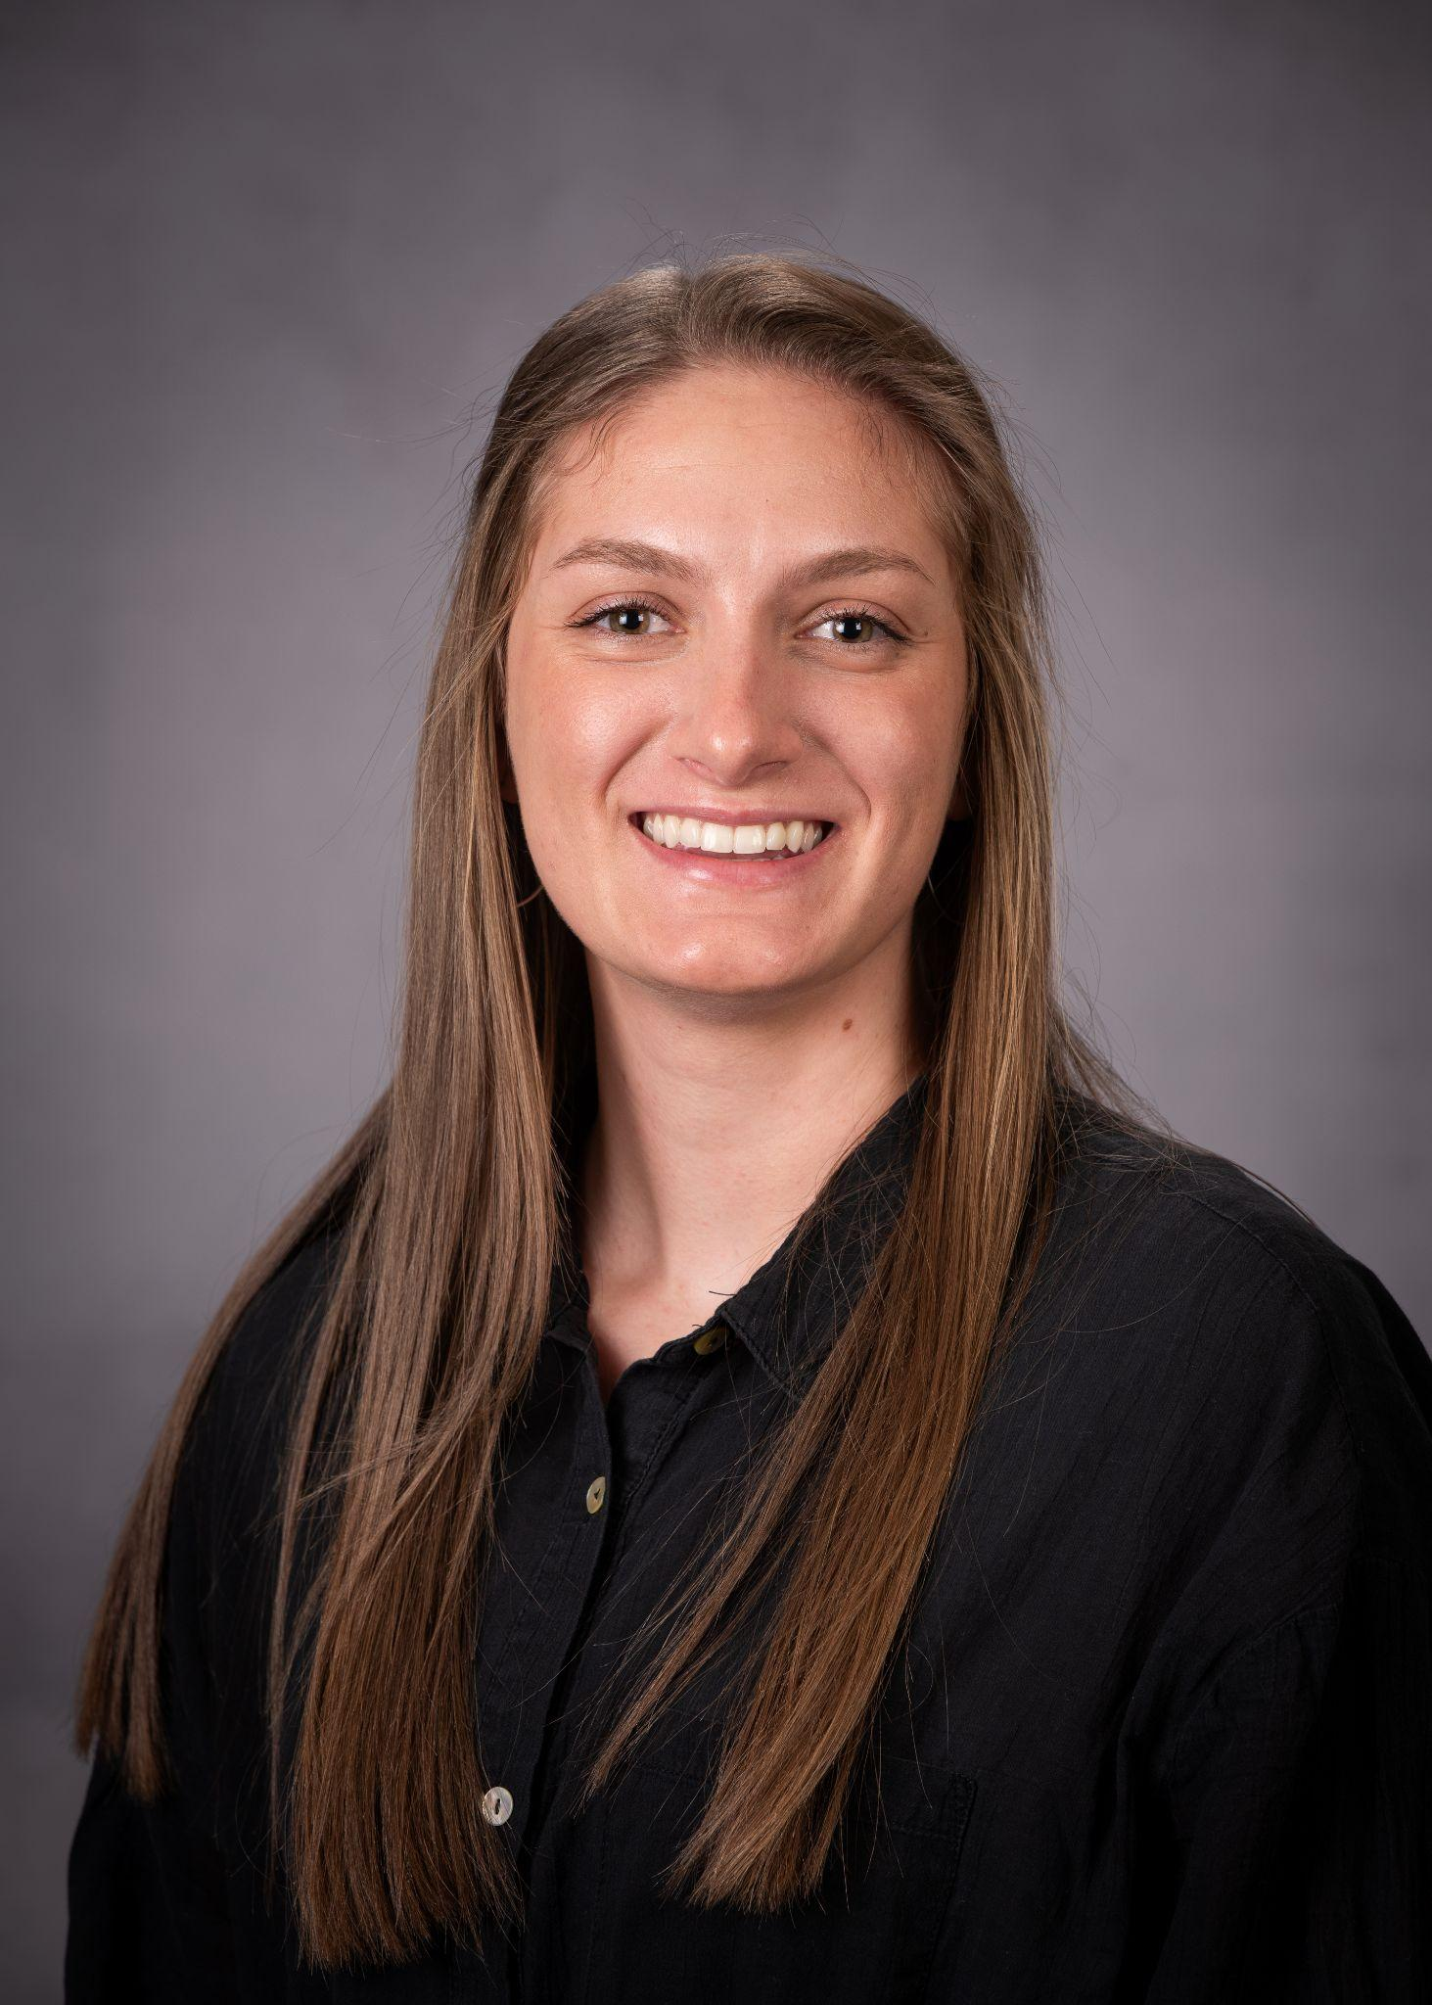
Mel’s Pops
By: Olivia Grayson
Senior Project - Winter 2025

Slide 2

First Meeting:
Her Goals:
Build her social media
Make her a website
Update her Logo
My Goals:
Tell her story
Bring organization
Make and build a plan that is maintainable after I leave

Slide 3
Weekly Schedule:
Tuesdays/Thursdays: Social Media Work
Shoot and edit 3 pieces of content each day
Create value packed captions
Research trends and find audios/ concept ideas
Goals:
Increase views and followers
Find manageable ways/ tips and tricks for Melanie to continue this after I am gone
Tell her story (show who Melanie is)
Mondays/Fridays: Organizational Management
Create a website
Create a separate Gmail and Email Campaigns
Redesign logo and color scheme
Take quality photos of Mel’s Pops
Goals:
Change the look of Mel’s Pops to be more versatile
Have a place where customers can go to learn more about Mel’s Pops, see her work, and get questions answered
Tell her story (show who Melanie is)

Slide 4

Senior Project
Social Media
Social Media

Slide 5
Change we saw after I started posting with Mel’s Pops:
Senior Project
x2
FOLLOWERS
Social Media
x3-x19
CONSISTENT VIEWS
x2
SALES

Slide 6
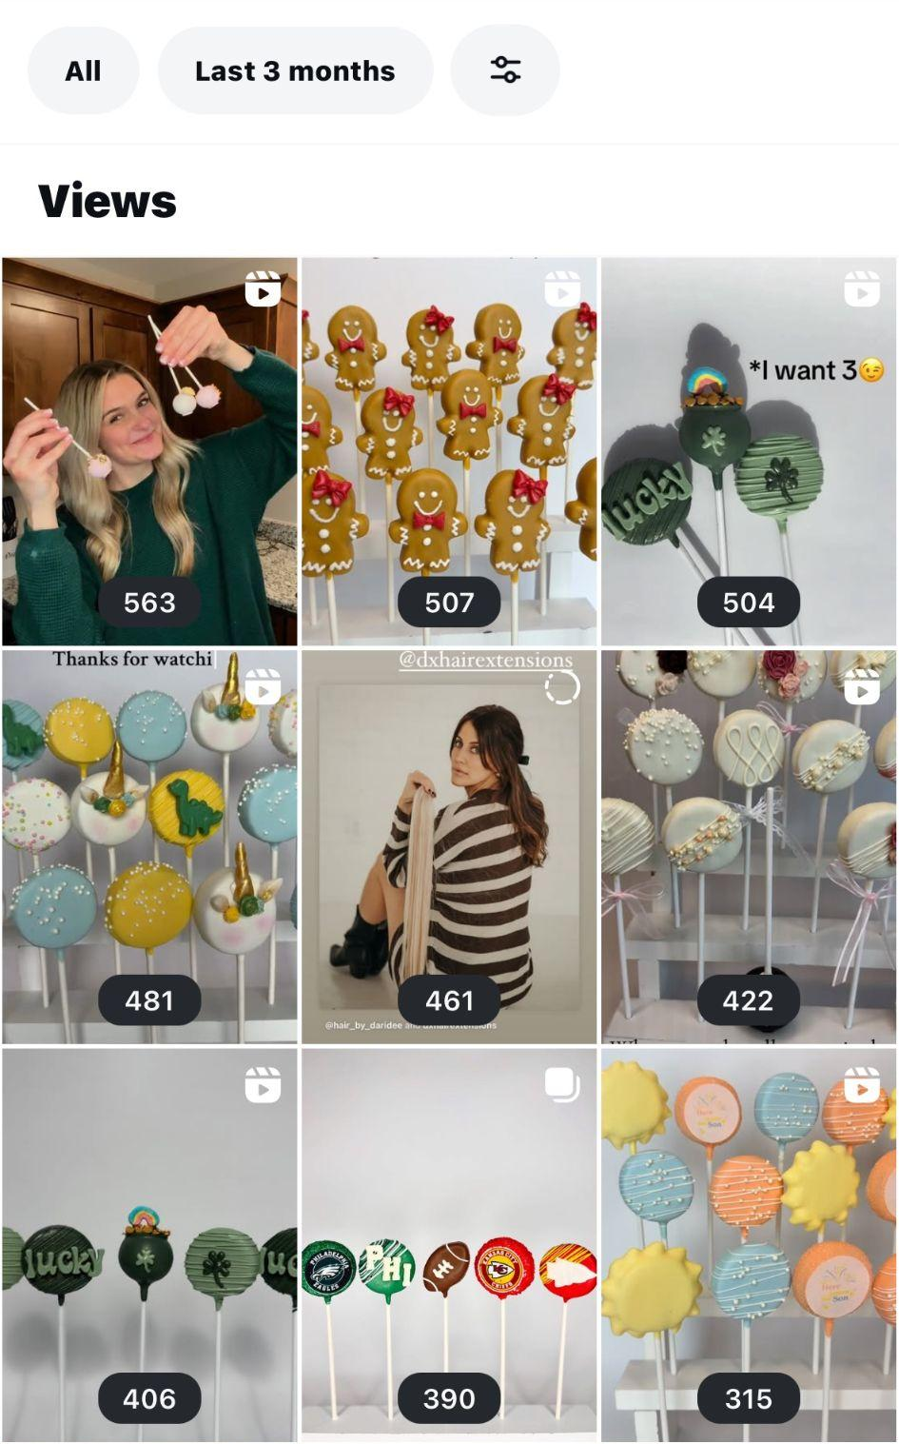
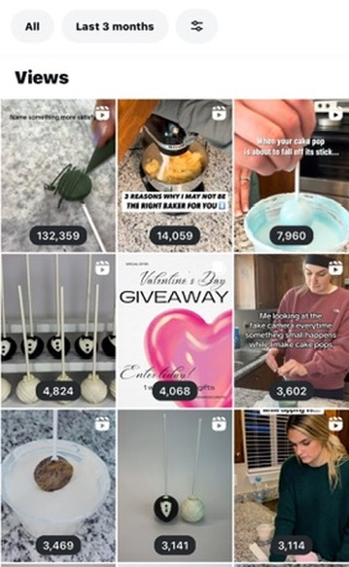
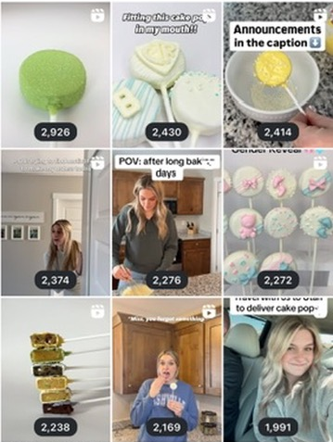
Change we saw after I started posting with Mel’s Pops:
Senior Project
Social Media

Slide 7
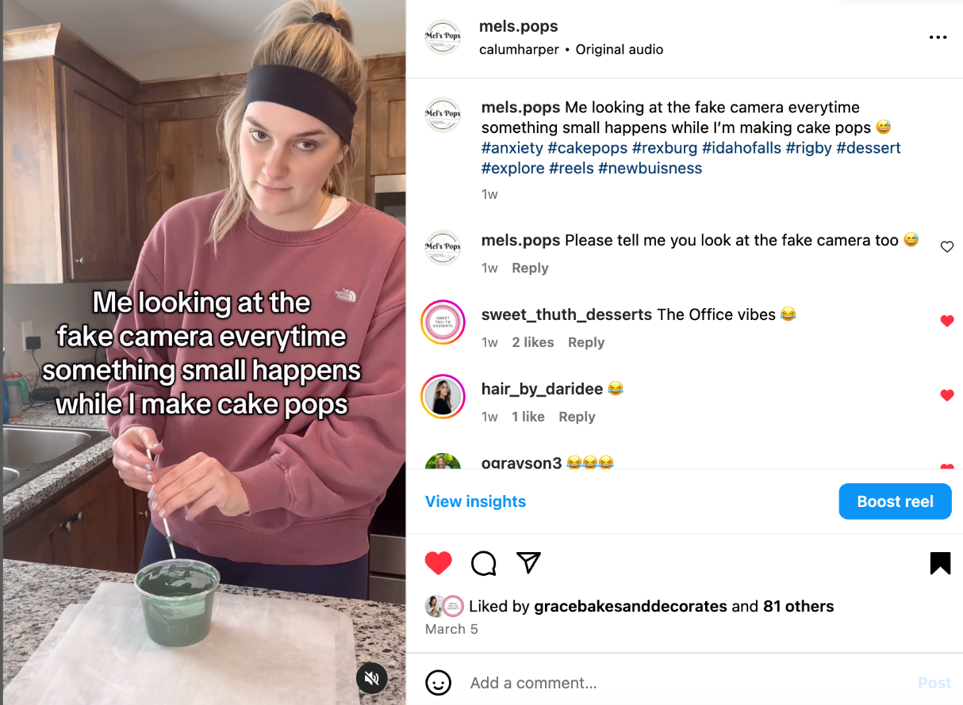
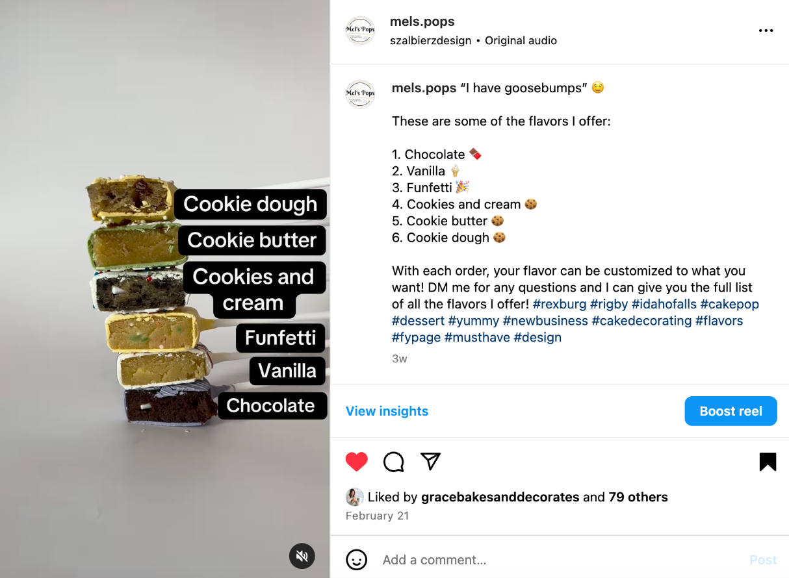
Example Posts:
Senior Project
Personality Content
VS.
Product Content
Social Media

Slide 8



Social Media Links to Mel’s Pops:
Senior Project
Social Media
Instagram
Facebook
TikTok

Slide 9
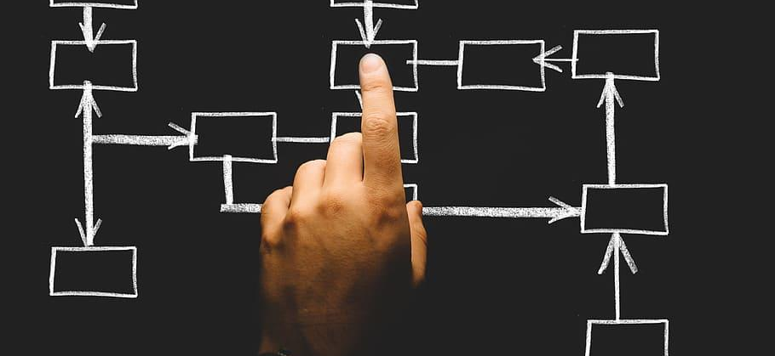
Senior Project
Organizational Management
Organizational Management

Slide 10

Logo Redesign:
Senior Project
Organizational Management
I originally created Mel’s Pops logo about a year ago. This design fit the birthday parties, celebration, and different events she was trying to get her name attached to.
This new logo shows the growth Mel’s Pops has made in a year. Her rebrand is now more versatile and shows her work can be classy and fit any event, like a wedding. This opens a whole new market for her.

Slide 11
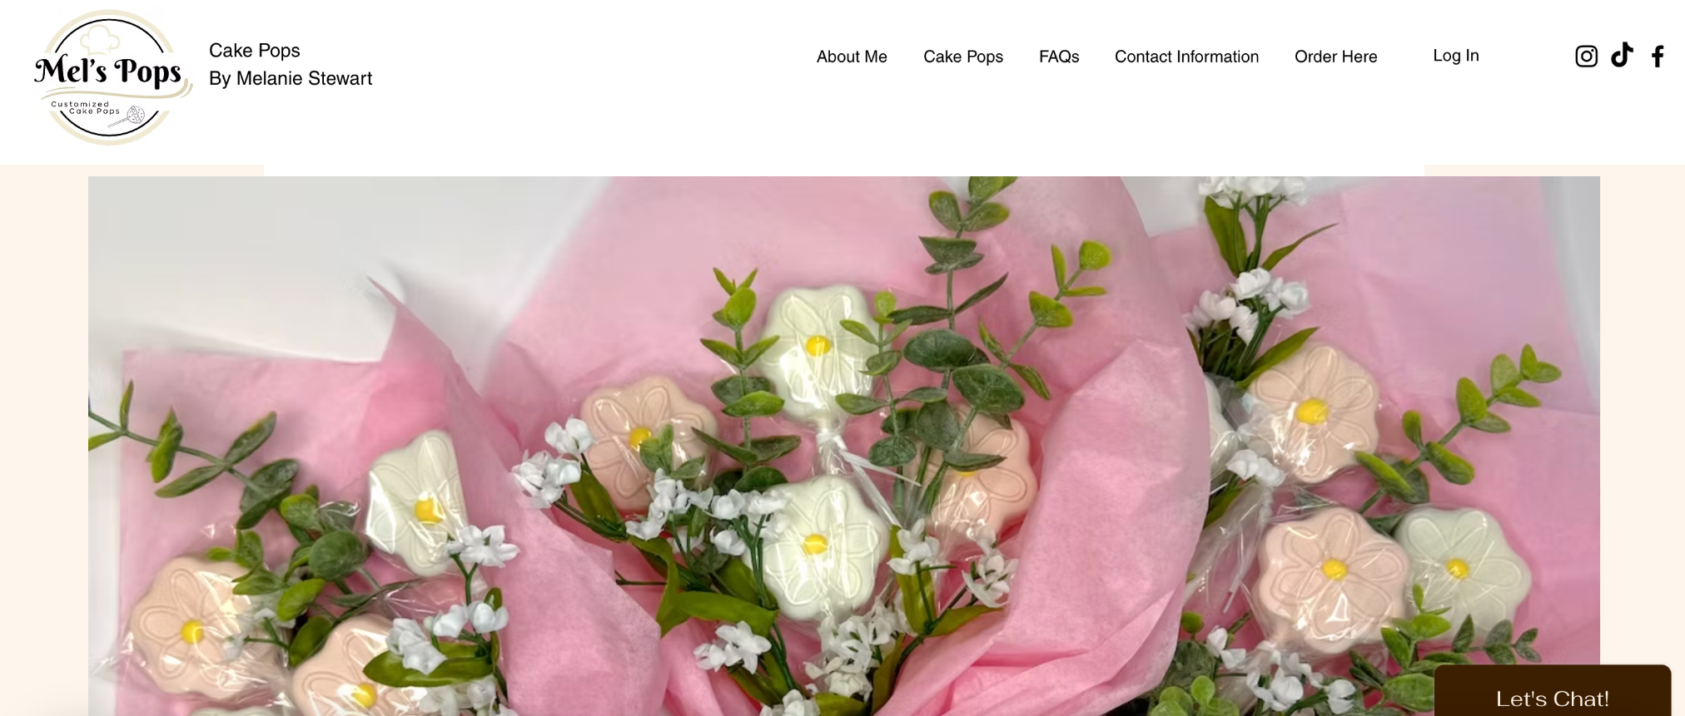
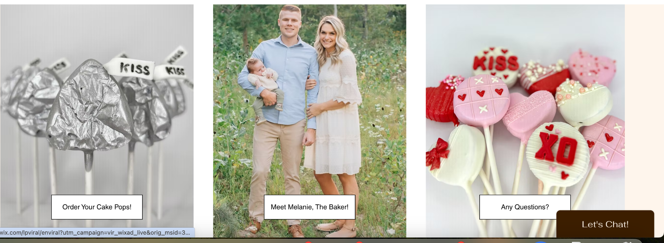
Website:
Senior Project
Organizational Management
https://melspops1997.wixsite.com/cake-pops
Mel’s Pops website went through a lot of changes as it was being made. There was a lot of collaboration with Melanie and her husband to make sure it was exactly what they wanted. Ultimately the website ended up not being able to take orders but it is clear to the customer where they can go to order cake pops.

Slide 12
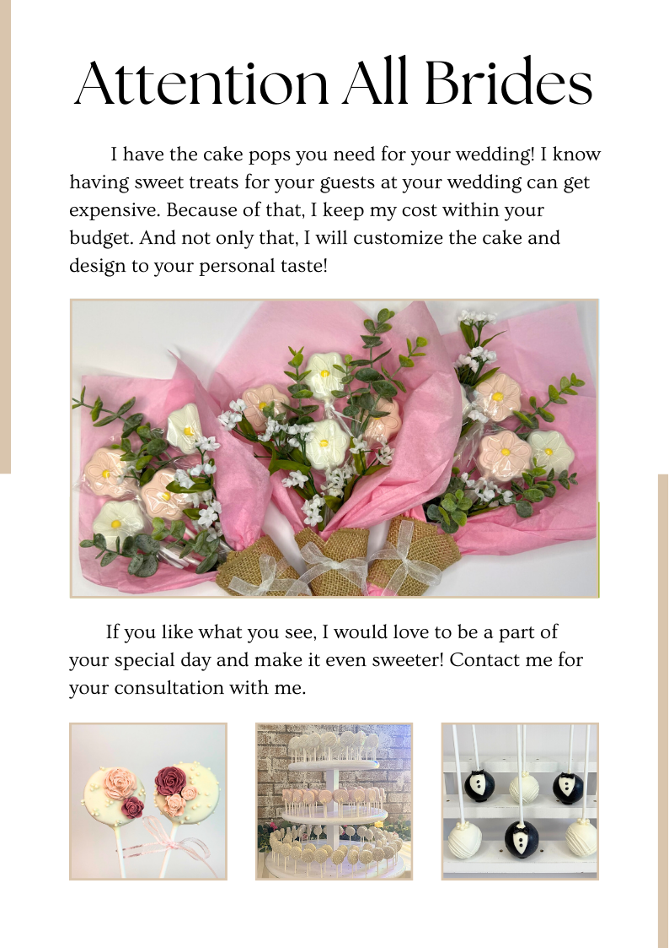
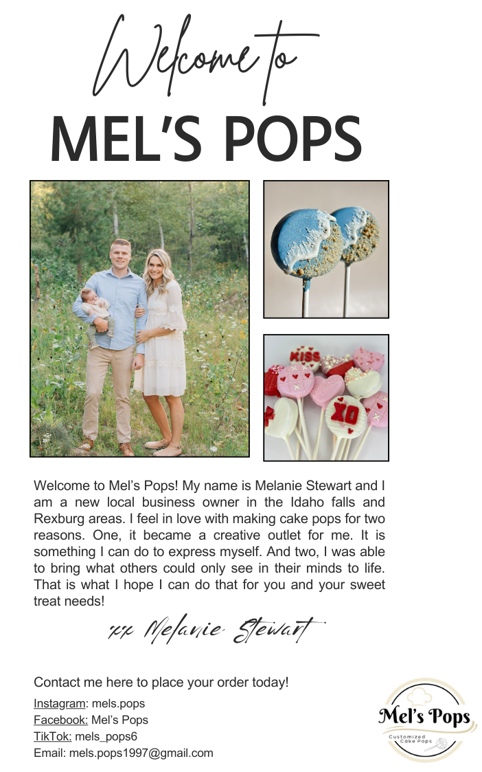
Email Campaigns:
Senior Project
Organizational Management
Wedding Email Campaign made based on a recent fair Mel’s Pops attended. This will remind brides what options Mel’s Pops offers and where they can order with her.
Introductory Email Campaign to show new and past clients where they can find and reorder with Mel’s Pops and show them progress in company

Slide 13
Thank You
Olivia Grayson

